Slide 1
IDS PROJECT
Team Galactic stars:
Pruthvish E PES1201701629
Ashrith Sridhar PES1201700649
Vaibhav K T PES1201700924

Slide 2
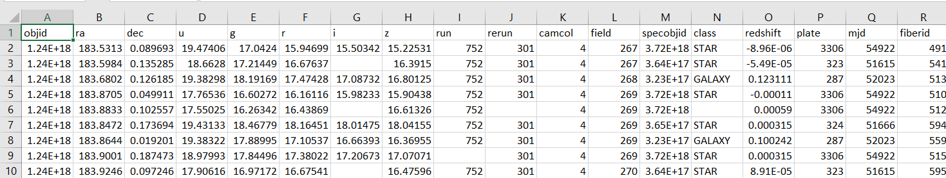
Our dataset :
Dataset : Sloan Digital Sky Survey RD14
Number of rows : 600
Number of columns : 18
Number of categorical features : 7
Number of numerical features : 9

Slide 3
Data cleaning:
All the NAN values for categorical columns are replaced with its previous row value, using the following code:
df['class'].ffill(inplace=True)
df['run'].ffill(inplace=True)
df['rerun'].ffill(inplace=True)
All the NAN’s for numeric columns replaced with average of the column, with the following code:
df['i'].fillna(df['i'].mean(),inplace=True)
By studying the data we observe that objid and rerun values are the same for every row so we will remove it for better data analysis, using the following code:
del df['objid’]
del df['rerun']

Slide 4
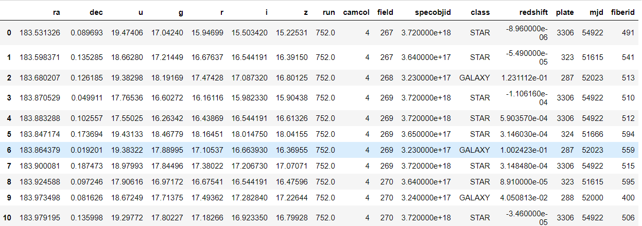
Our dataset after Data Cleaning process:

Slide 5
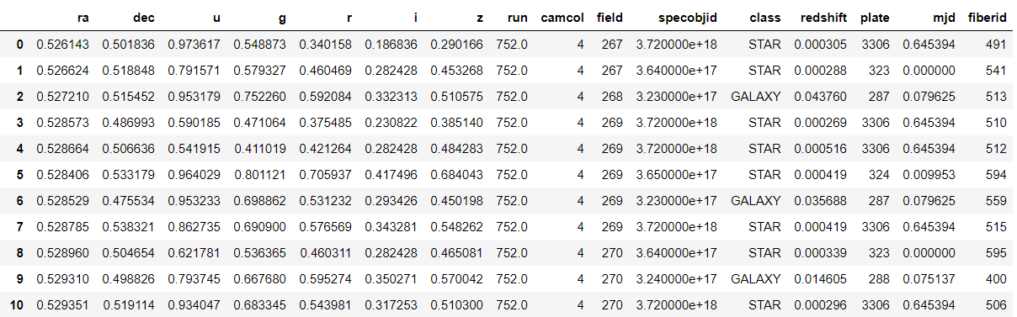
Normalization and Standardization
Normalizing only numeric features:
cols_to_norm = ['ra','dec','u','g','r','i','z','redshift','mjd']
df[cols_to_norm] = df[cols_to_norm].apply(lambda x: (x - x.min()) / (x.max() - x.min()))
Dataset after normalization:

Slide 6
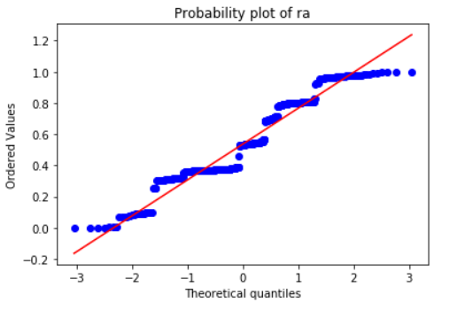
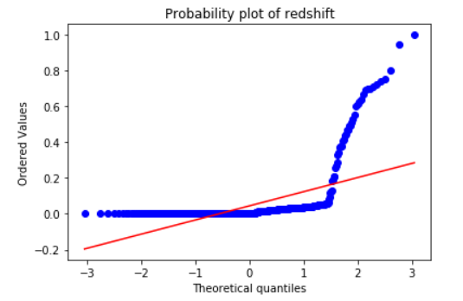
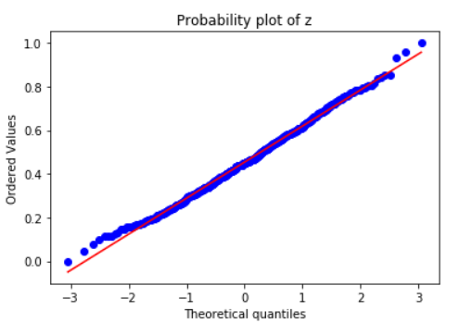
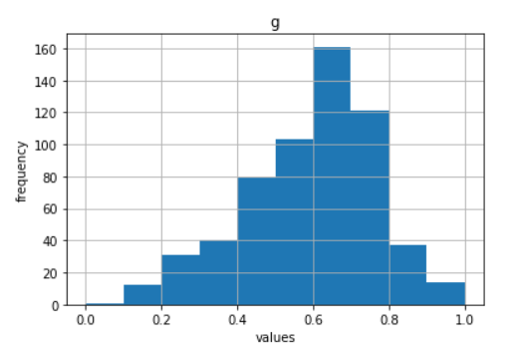
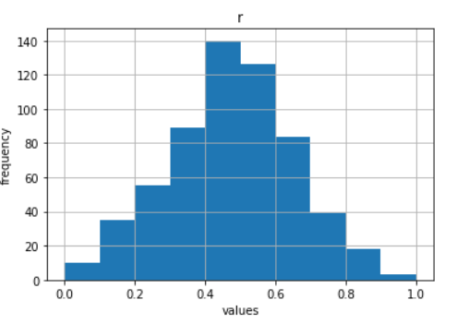

Slide 7
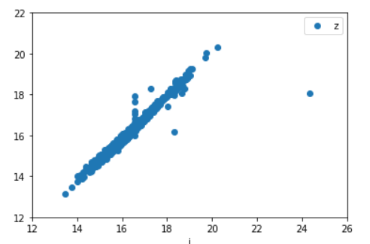
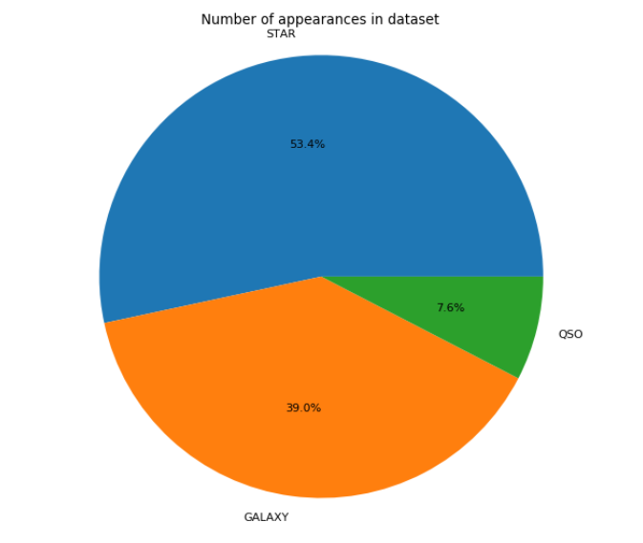
Graph visualization
We see that Scatterplot for infrared and 900nm response of the telescope are correlated as their plot is almost linear.
This is clear as infrared wavelengths (700nm and above) and 900nm are almost near hence response of the telescope is almost the same.
We can see from the Piechart that most of our dataset contains Stars .
Very few, 7% of our dataset contains quasars which says that quasars are very rare whereas stars occur in abundance.

Slide 8
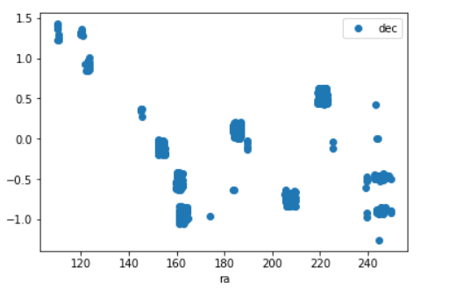
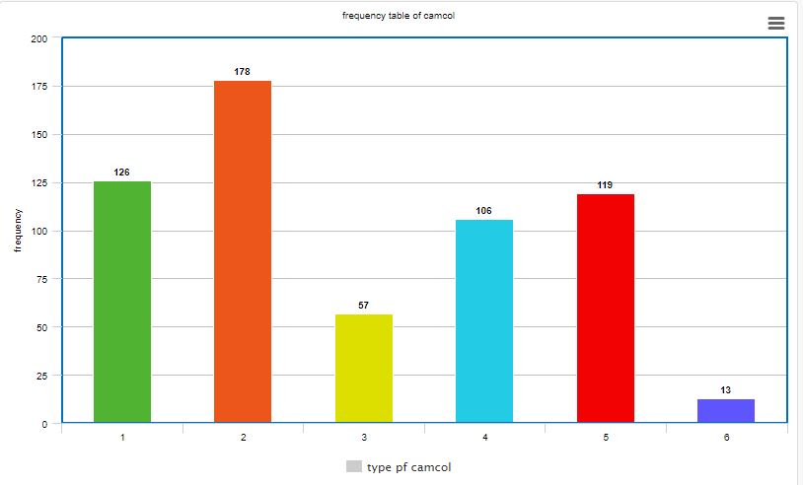
We see from the Scatterplot that ra and dec are not correlated.
This is obvious as the right ascension angle and declination angle do not depend on each other and infact ra is kept constant and dec is changed to various angle and vice versa.
We can see by this Bar graph that camera scanline within the run is used maximum for 2.

Slide 9
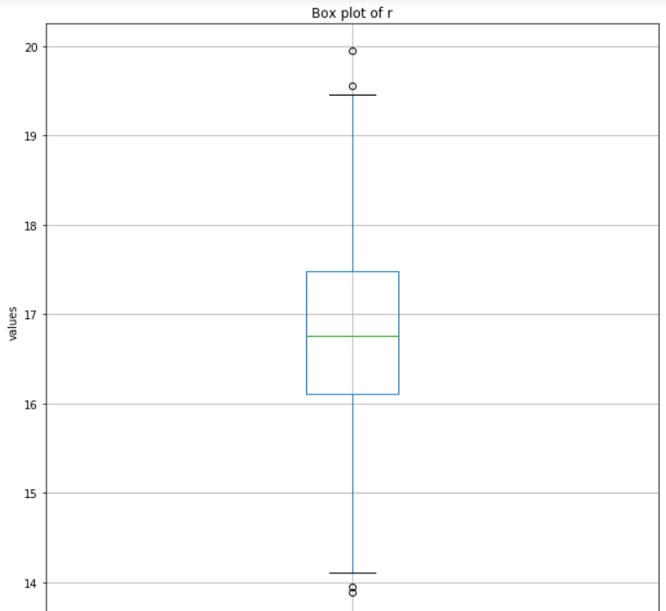
Box plot of r
We can see that the response of the telescope to red band ranges from 14.1 to 19.5 with median of 16.8 with some outliers in minimum as well as maximum end.

Slide 10
Hypothesis testing:
Two sided hypothesis test
H0 : μ = 185.01467401969944
H1 : μ != 185.01467401969944
Alpha value is : 0.05
Actual z value : 1.9599639845400545
Hypothesis z value : 2.1899914168152192
Reject NULL hypothesis
One sided hypothesis test
H0 : μ <= 18.540124941569278
H1 : μ > 18.540124941569278
alpha value is : 0.05
actual z value : 1.6448536269514729
hypothesis z value : -0.9591187844229192
Failed to reject NULL hypothesis

Slide 11
THANK YOU

